Slide 1
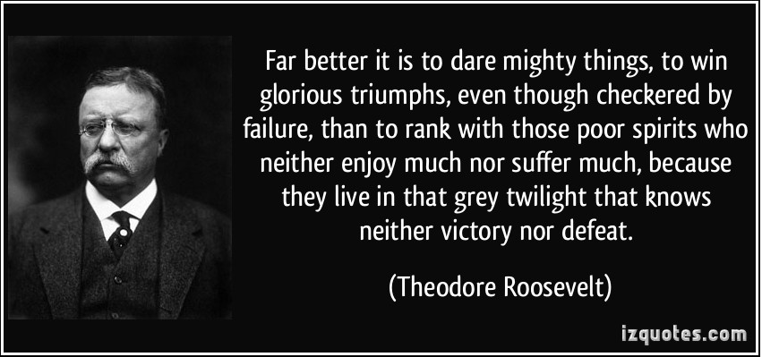
Warm Up #1.
Third, analyze the quote and write what you think Roosevelt is saying in your own words. 3-5 sentences.

Slide 2
Warm Up#2
I want you to think about your best friend or someone you are close with.
What words would you choose to describe their personality?(1 sentence)
Can you give at least one example or evidence that displays this personality? (2-3 sentences)
For instance:
My dog is desperate and loving.
Every morning when I crack open my eyes, I am greeted by Aggie, my dog, and her breath. She’s always there sitting, ready, with a wagging tail and a slobbery smile waiting for the first pat of the day. As I get up, she moves just out of my way while maintaining a nearness to me that borders on creepy. She follows me from the room to the kitchen and around the house always wagging, eyes locked on my movements prepared to be there if I need her, living to love and be loved.

Slide 3
Warm Up #3
Warm Up#3 (from last week)
Think about what the phrase “tough love” means. Be ready to define it.
THINK & RESPOND: Have you ever experienced “tough love”? Have you ever given “tough love”? Received “tough love”?

Slide 4
Warm Up #4
The questions are about The Rights to the Streets of Memphis. Only write the answers.

Slide 5
For Warm Up#5 write your thoughts on one of the events of this week:
-Colin Kaepernick’s political statement by remaining seated during the National Anthem.
-Donald Trump met with Mexico’s President Pena yesterday in Mexico. Mr. Trump said they didn’t discuss the Wall. Pena said they did.
Tomorrow’s first home sports game against other high school students living in other town.
Or another topic I did not mention that you would like to share your thoughts on.

Slide 6
Warm Up #6
What is the significance of the relationship between you and the person who showed you tough love?

Slide 7
Warm Up#7
Think about everyone you know and consider the best people among them.
Which one contributes most to your community?
Explain how that individual makes the world a better place than everyone can benefit from.

Slide 8
Warm Up #8
Share a true story about when something funny happened to you. Use a simile and a metaphor. This must be 5-10 sentences long.

Slide 9
Warm Up #9
Prompt: Write an Expository Narrative article about an individual you know that contributes to the community.
Consider the prompt above and complete the task below for your warm up today. It should be 3-5 sentences AT LEAST and be completely narrative (try using imagery, a simile, or a metaphor!).
Write an anecdote, or brief story, about the individual that highlights their positive character trait which makes them such a contributor to their community.
When we came to the stoplight I noticed my father was reaching into his wallet. I knew that we were short of cash that month because we had to sell some of our toys and our bikes. But my dad handed the man a worn out $10 bill. The man’s eye lit like a fire and he smiled from ear to ear. “Sometimes, $10 gets you more than you can buy,” my dad offered. I still think about that line.

Slide 10
Warm Up # 10 (the final one)
As the six weeks comes to a close I want to use the final Warm Up to reflect. Write about one thing you liked, one thing you hated, and one thing you learned. That’s three things. Organize your thoughts. No less than 5 sentences for credit.
I.E.
This six weeks seemed more like a year! I liked …. However, there was one thing I didn’t like: …. In the end, I learned….

