Slide 1
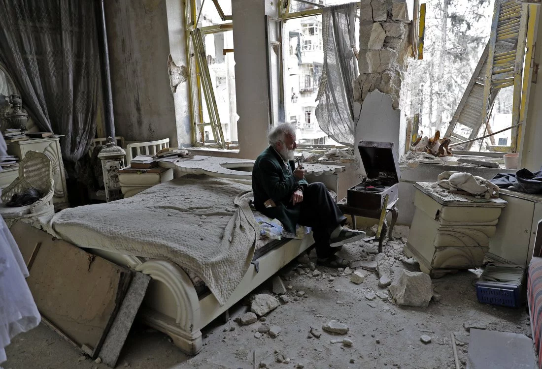
Warm Up #13
After looking closely at the image, think about these three questions:
• What is going on in this picture?
• What do you see that makes you say that?
• Make a prediction. What will happen next?
Respond to each question with at least one sentence.

Slide 2
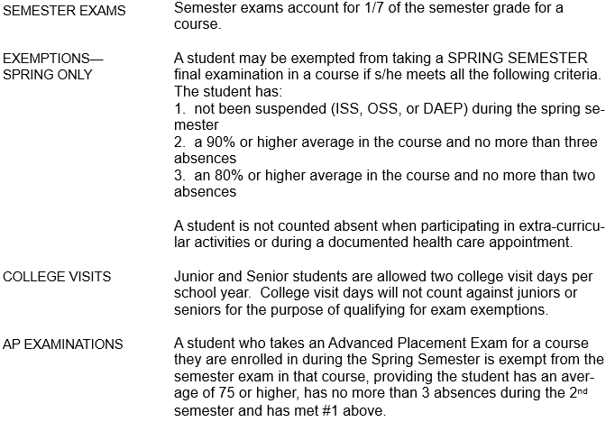
Semester Exams

Slide 3
STAAR Testing Strategies
When you go and take you exams next week, you’re going to want to be as prepared as possible.
Let’s talk about some strategies for the test!

Slide 4
STAAR Testing Strategies
There are two sections to the test: READING and WRITING.
For each section there are 5 different text passages that you will need to read for each section. That’s 10 passages total.
There are 52 multiple choice questions.
There is a single essay.
You will be given 5 hours to take the test.

Slide 5
BEFORE THE EXAM
Sleep well the night before! Get at least 8 hours of sleep.
Eat well the night before and the morning of the test. This is your ONLY source of energy. Without it, you will tire quickly!
Wear layers. The room you’re testing in may be cold or hot. Layers give you options.
Arrive on time! Testing begins at 9am!

Slide 6
At the start of the test…
Stay relaxed and confident. The test will be over in 5 hours no matter what happens. All you can do is try your best.
Read directions carefully and completely. This will help avoid making simple or silly mistakes.
Answer the questions in STRAGETIC order.

Slide 7
Taking the test…
The ESSAY is the heaviest weighted and most important.
Plan out your essay FIRST! Take 10-15 minutes to just consider the prompt and think of ideas. Write a rough draft using a 4 paragraph outline. DON’T WRITE THE ESSAY ON THE ANSWER SHEET YET!

Slide 8
Taking the test…
After you have outlined your essay and composed a rough draft, turn to the READING SECTION.
Read all the selections and answer the 34 reading comprehension questions.
We’ll discuss strategies for that section in a moment.

Slide 9
Taking the test…
After you complete the reading section, go back and reread your essay with fresh eyes. Correct mistakes and make sure it flows well. Write your Final Draft on the answer document.
Now, all writing and reading comprehension questions are DONE. Focus the rest of your time to answer the revising and editing multiple choice questions. This is the fastest portion of the test to take.

Slide 10
Multiple Choice Strategies
Answer easy questions first. If a question is difficult, mark it on the test and come back to it after you’ve finished the questions for that section.
Do not second guess your first answers. Your first answer is more likely to be correct.
If two answers look alike, then is probable that one of them is correct.

Slide 11
Multiple Choice Strategies
Always guess. If you don’t know the answer, use hints and clues to eliminate as many choices as possible and choose the answer that makes the most sense or seems most correct.
THERE IS NO PENALTY FOR GUESSING! BLANK ANSWERS ARE ALWAYS WRONG!
You are looking for the answer that is MOST right, not just correct.

Slide 12
STAAR Video!
https://www.youtube.com/watch?v=lHUSKnBCwSc

