Slide 1
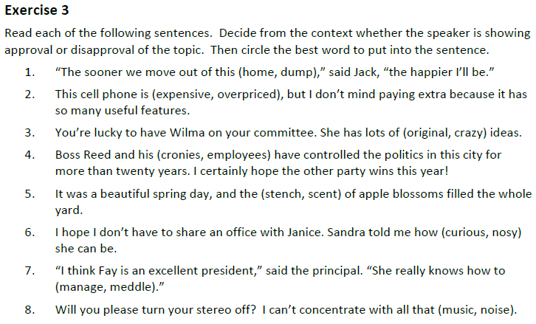
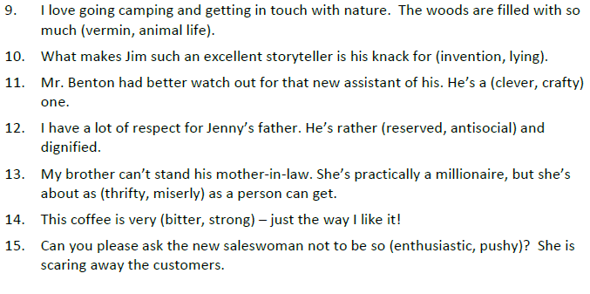
Get out your Connotation worksheet and finish Exercise 3 on the back. Make sure your name is on your paper.

Slide 2
Get out your Connotation worksheet and finish Exercise 3 on the back. Make sure your name is on your paper.

Slide 3
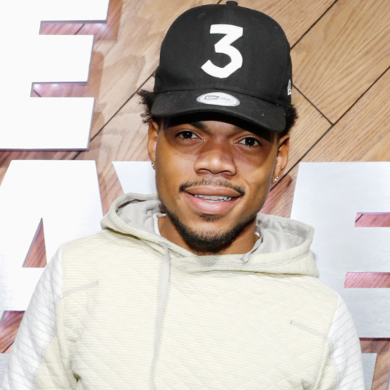
Slide 1
Song Title: Sunday Candy
Artist’s Name: Chance the Rapper
Your Name: Mr. G
Class Period: All
Date: Today

Slide 4
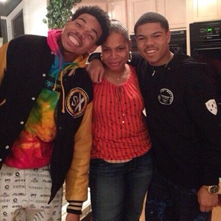
Slide 2
Song Title: Sunday Candy
Artist’s Name: Donnie Trumpet and the Social Experiment
Lyrics (20 lines at least)
She could say in her voice, in her way that she love me in With her eyes, with her smile, with her belt, with her hands, with her money I am the thesis of her prayers Her nieces and her nephews are just pieces of the layers Only ones she love as much as me is Jesus Christ and Taylor I got a future so I'm singing for my grandma You singing too, but your grandma ain't my grandma Mine's is hand made, pan fried, sun dried Southside, and beat the devil by a landslide Praying with her hands tied, president of my fan club, saying to her Something told me I should bring my butt to church
I come to church for the candy, your peppermints is the truth I'm pessimistic on Monday if I had tweaked and missed you You look so good with that hat on, had to match with the shoes Came and dressed in the satin, I came and sat in your pew I come to Christmas for dinner, fifty rolls on my plate Hella holes in my stocking holding your pockets in place I like my love with a budget, I like my hugs with a scent You smell like light, gas, water, electricity, rent You sound like why the gospel choir got so tired Singin his praises daily basis so I gotta try it You're my dreamcatcher, dream team, team captain Matter fact, I ain't seen you in a minute let me take my butt to church
PICTURE related to the song’s content

Slide 5
Slide 3
Theme
Title + Genre + Author’s Name + Analysis Verb + Subject (what should the reader learn about it)
“Sunday Candy,” a song by Donnie Trumpet and the Social Experiment argues that love comes in many forms.
Support theme statement with lines from the lyrics. Make sure to explain how the quotes indicate the theme of the song (at least 3 examples)
“I am the thesis of her prayers” – Chano is stating that when his Grandmother is praying to God her main focus of her prayers is Chance.
“President of my fan club” – Chance is using this metaphor to show that his Grandmother is always supportive of him.
“Like my love with a budget, I like my hugs with a scent You smell like light, gas, water, electricity, rent”- Chance is using imagery to illuminate that his Grandmother made sacrifices by paying her bills. Chance sees this responsibility its own form of love.
“I come to Christmas for dinner, fifty rolls on my plate Hella holes in my stocking holding your pockets in place”- His grandmother wasn’t able to give him all the gifts other grandparents lavished their grandkids with, but by making sacrifices in that way she was able to provide plenty of that which Chance needs like food.

Slide 6
Slide 3
Theme
Title + Genre + Author’s Name + Analysis Verb + Subject (what should the reader learn about it)
“Sunday Candy,” a song by Donnie Trumpet and the Social Experiment argues that love comes in many forms.
Do you agree or disagree with the lyrics? Explain your reasoning. (5 sentences minimum)
I completely agree with the lyrics because…

Slide 7
Slide 4
Mood
What is the mood of the song? The mood is the sentiment or feeling that is impressed upon the reader through the words (diction).
The mood of “Sunday Candy” is comforting and loving.
Support mood statement with lines from the lyrics. Make sure to explain how the quotes indicate the mood of the song (at least 3 examples)
“I'm pessimistic on Monday if I had tweaked and missed you” is used to describe the way Chance feels when he doesn’t see his Grandma at church on Sunday conveying his dependence on his Grandmother’s love.
“I come to Christmas for dinner, fifty rolls on my plate” conveys a sense of satisfaction because Christmas is a happy holiday spent with loved ones and having plenty to eat is a basic instinctual need creating a pleasant and loving mood.
“You're my dreamcatcher, dream team, team captain” indicates the position Chance’s grandmother holds in his life as someone of extreme importance. His description of her as a member of his team and, even, its captain conveys a supportive tone creating a mood that is comforting.

Slide 8
Slide 5
Imagery
PICTURE (that relates to the Mood)
Lyrics containing imagery + Imagery statement (from yellow packet) (3 examples at least)
“ “ - The image of ________ depicts a (picture/sense/state, etc…) of ___________________________ because the reader (sees, envisions, realizes) that _____________________________________________________________.
“I like my hugs with a scent You smell like light, gas, water, electricity, rent”
This creates an image of responsibility because the reader sees that Chance is saying that his grandmother doesn’t smell like expensive perfume; instead, she smells like the responsibilities she takes care of despite her poverty. By acknowledging her sacrifice, Chance is indicating his appreciation.
PICTURE (that relates to the imagery)

Slide 9
Slide 6
Figurative Language
Lyrics containing Figurative Language + Commentary using the sentence stems from the yellow packet (Metaphor, Simile, or Personification) and explaining the effect of the imagery (3 examples at least).
“beat the devil by a landslide”
The subject of the devil is being compared to the vices and evils of the world in this metaphor. This is fitting because both the devil and evils of the world are bad things that can ruin your life. By describing is as “a landslide,” Chance is indicating that in the election for his loyalties, whether for the good represented by his grandmother or evil symbolized by the devil, that he voted overwhelming to follow his Grandmother on the path of good.
“Praying with her hands tied”
The subject of Chance’s grandmother’s hands being tied is compared with poverty. This is fitting because having one’s hands tied and poverty are both very restricting in what you are capable accomplish. Chance is commenting that even though his grandmother had to struggle with the restrictions of poverty, she took time for her duties such as praying and also caring for Chano.
“president of my fan club”
The subject of president of a fan club is being compared with Chance’s grandmother’s support of him and his career. This is fitting because a fan club is made of the most passionate fans of a subject, but to be the president of that club indicates a superior affection. Chance’s grandmother has always been there for him and he appreciates her contributions and support.

