Slide 1
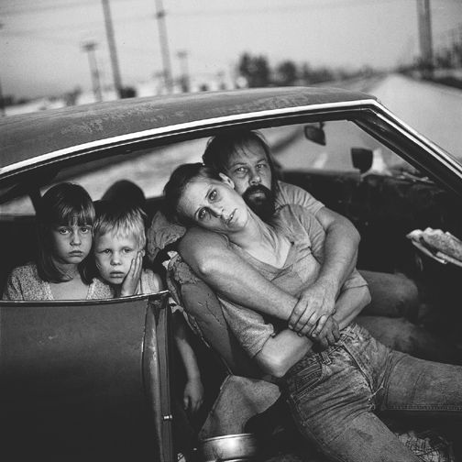
It’s a new six weeks, soooo
Warm Up #1
What would you think if you saw this family on the street? What kinds of assumptions and judgments would you make? Have you seen families like this before? How do you think they feel? (5 sentences)

Slide 2
Homelessness In America
Quick Write #1:
Watch the video: https://www.youtube.com/watch?v=5TelyWI6oko&feature=related
Write a response to the statistic you find most surprising.

Slide 3
Warm Up #2
Look up the definition for MEMOIR
MEMOIR:
How reliable is memory? Do you and your siblings remember events from your childhood the same way? If not, why do you think this is so? (3-5 SENTENCES)

Slide 4
Warm Up #3
(3-5 SENTENCES)

Slide 5
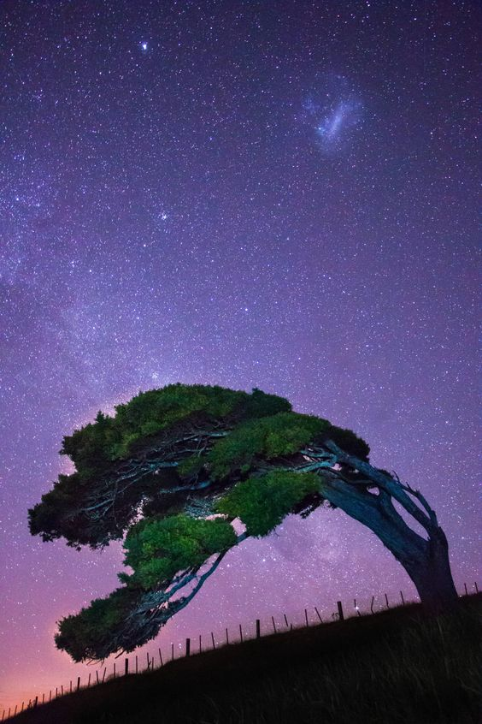
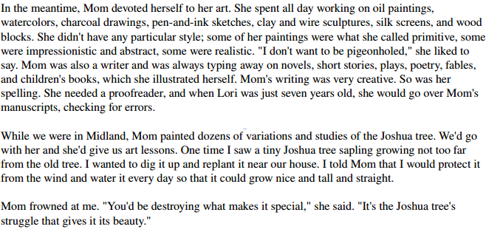
Warm Up #4
What does the Joshua Tree symbolize? Identify what it symbolizes and explain in 2-3 sentences.

Slide 6
Warm Up #5
First, characterize Billy Deel. Describe his looks, background, and personality.
Second, summarize a story about Billy Deel. (At least three sentences)

Slide 7
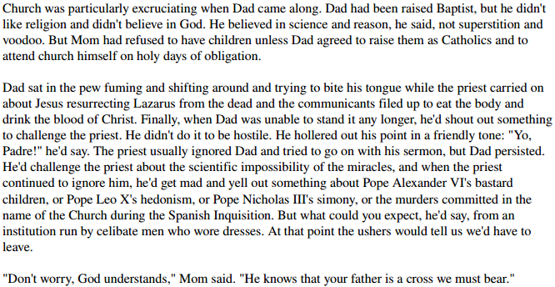
Warm Up #6
Explain what Rose Mary means by this metaphor. By using this metaphor, Jeanette’s mom is making a comparison between them and another individual. Who are they being like for bearing Rex Walls? (At least 3 sentences!)

Slide 8
Warm Up #7
Will you raise your children the same way your parents raised you? Explain.
At least a paragraph.

Slide 9
Warm Up #8
Do you think that difficult family circumstances bring siblings closer together or push them apart? Explain.
(5 sentence paragraph is a minimum)

Slide 10
Warm Up #9
Consider a time when you did something that would have resulted in severe consequences had you been caught. How did this affect the way you felt about taking risks?
(5 sentence paragraph minimum)

Slide 11
Warm Up #10
Bob Dylan once wrote…..
“A man is a success if he gets up in the morning and gets to bed at night and in between does what he wants to do.”
Although it seems a stretch to use the word “success” in any discussion of the Walls’ lifestyle, using Dylan’s definition, could we say that Rex and Rose Mary were a success?
How do you define success?
(4 sentences at least)

