Slide 1
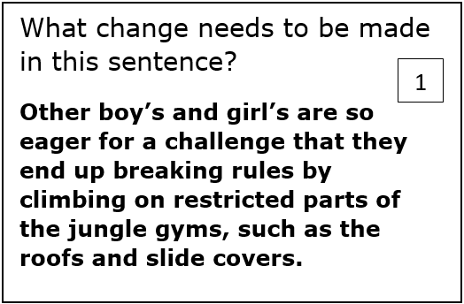
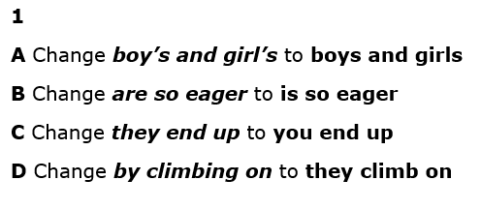
Warm Up#1a
Write the entire sentence without the corrections, then make editing marks for FULL credit on Warm Up #1.

Slide 2
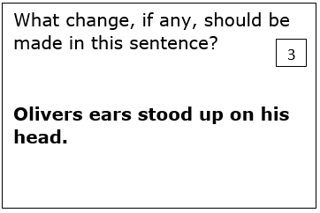
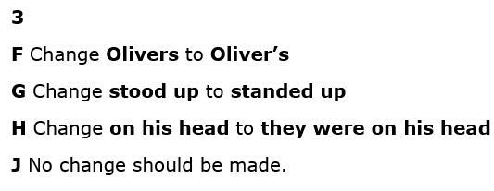
Warm Up#1B
Write the entire sentence without the corrections, then make editing marks for FULL credit on Warm Up #1.

Slide 3
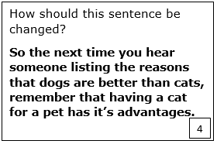
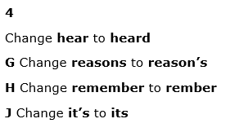
Warm Up#2a
Write the entire sentence without the corrections, then make editing marks for FULL credit on Warm Up #2.

Slide 4
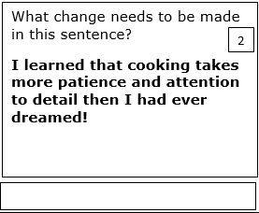
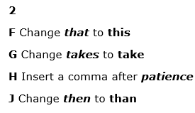
Warm Up#2b
Write the entire sentence without the corrections, then make editing marks for FULL credit on Warm Up #2.

Slide 5
Warm Up#3a
Write the entire sentence without the corrections, then make editing marks for FULL credit on Warm Up #3a.

Slide 6
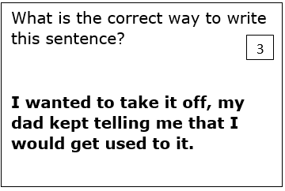
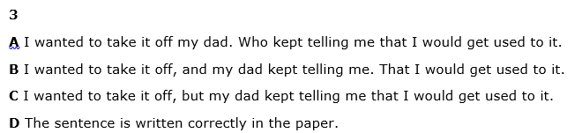
Warm Up#4
Write the entire sentence without the corrections, then make editing marks for FULL credit on Warm Up #4.
B I wanted to take it off, and my dad kept telling me that I would get used to it.

Slide 7
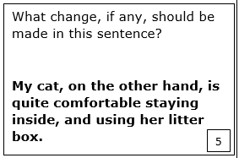
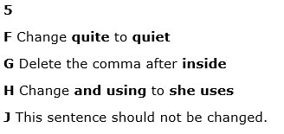
Warm Up #5
Write the entire sentence without the corrections, then make editing marks for FULL credit on Warm Up #5.

Slide 8
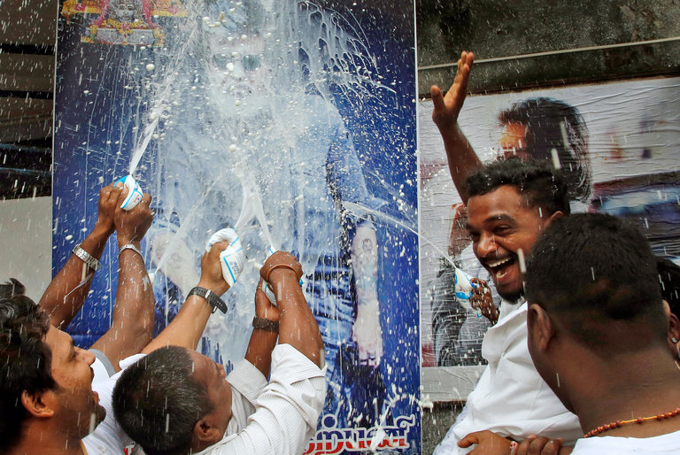
Warm Up #6
After looking closely at the image, think about these three questions:
• What is going on in this picture?
• What do you see that makes you say that?
• What more can you find?
Respond to each question with at least one sentence.

Slide 9
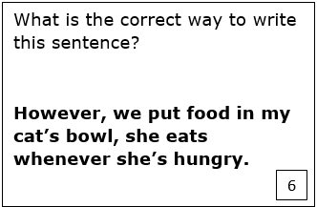
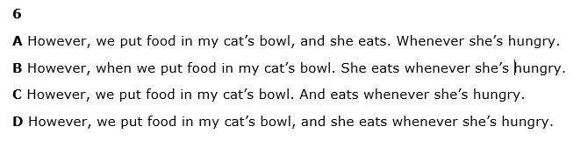
Warm Up #7
Write the entire sentence without the corrections, then make editing marks for FULL credit on Warm Up #7.

Slide 10
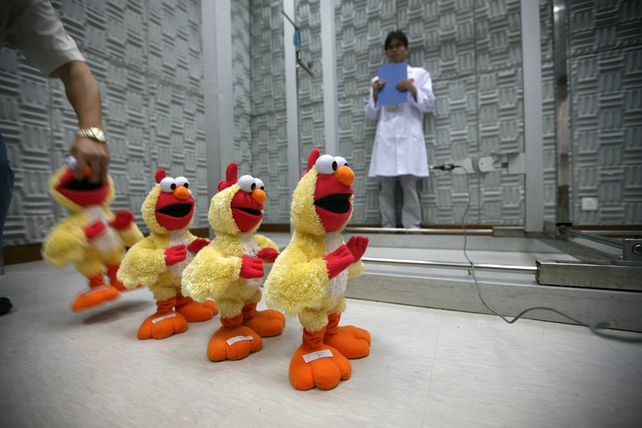
Warm Up #8
After looking closely at the image, think about these three questions:
• What is going on in this picture?
• What do you see that makes you say that?
• What more can you find?
Respond to each question with at least one sentence.

Slide 11
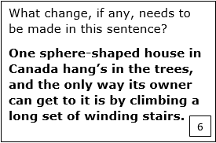
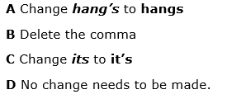
Warm Up #9a
Get out your Prompt & Outline
Write the entire sentence without the corrections, then make editing marks for FULL credit on Warm Up #9.

Slide 12
No Cellphones TODAY! Put them away.
Warm Up #10a
Turn to a clean sheet in your notebook for Warm Up 10a & b.
Today, for 10 minutes at least, I want you to write a half page about your Spring Break. Was is wasted? Was it well-used? Explain or Persuade!
This Spring Break was a break from the norm for myself and my wife Alexandra. We spent our entire break traveling around the world bouncing from continent to continent as we drank in the culture of every country we visited. We began by visiting Toronto, Ontario, Canada Saturday, March 11. It beyond freezing cold; the temperatures were the lowest of the year at -14 degree Celsius (whatever that is in Fahrenheit) . While there we enjoyed the sights Toronto offers but the most memorable part of Canada were the people. Canadians are the kindest people on Earth. Multiple times people helped us out without solicitation; nobody was every rude and people used the most polite tone when speaking with us. After Toronto, Alexandra and I went to Paris, France where we stormed around the city at a grueling pace seeing all the city could offer in as little time as we were there. We left with much of the city still undiscovered. We visited the historic Louvre Museum, the Centre de Pompidou (modern art museum), the Palace at Versailles, we ate meals with the locals and relatives, we took a boat tour of the city at night under the star like city lights, and we climbed the Eiffel Tower and the Sacred Heart Basilica. We also visited Brussels, Belgium for a day end got to see the gilded Grand Place square. Overall, the trip was amazing and I could write for hours on all we did and experience. But, alas, time is up and it time to begin our day!

Slide 13
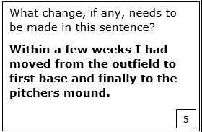
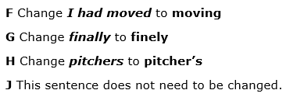
Warm Up #10B
Write the entire sentence without the corrections, then make editing marks for FULL credit on Warm Up #9.

Slide 14
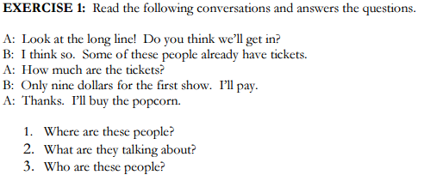
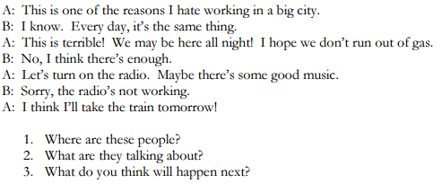
Warm Up #11

Slide 15
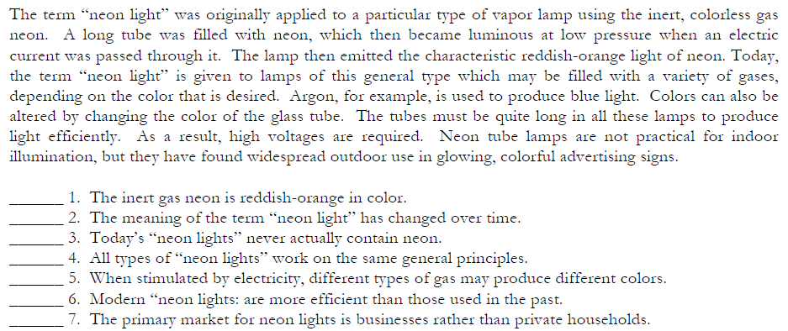
Do now – 5 minutes
Warm Up #12
Rewrite any sentence which is inferred from the selection.

Slide 16
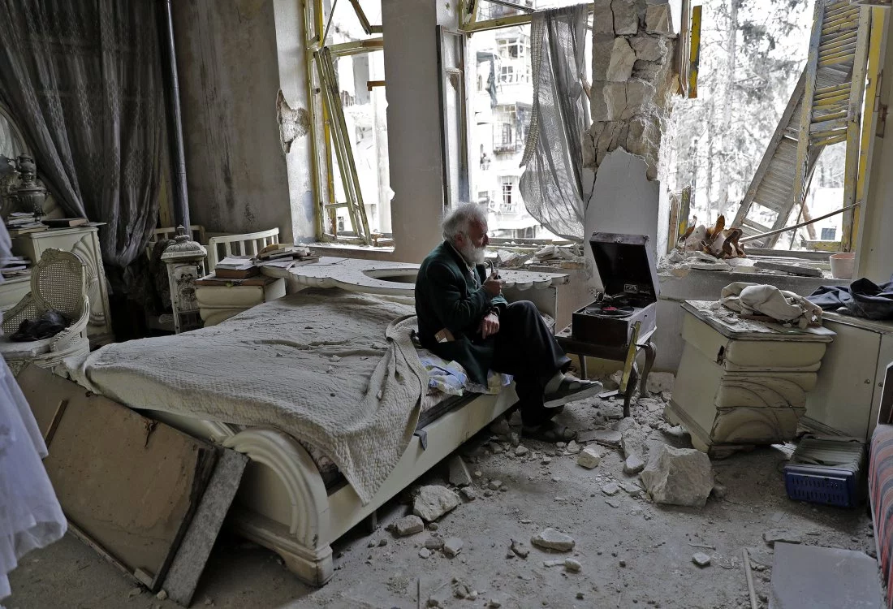
Warm Up #13
After looking closely at the image, think about these three questions:
• What is going on in this picture?
• What do you see that makes you say that?
• What more can you find?
Respond to each question with at least one sentence.

Slide 17
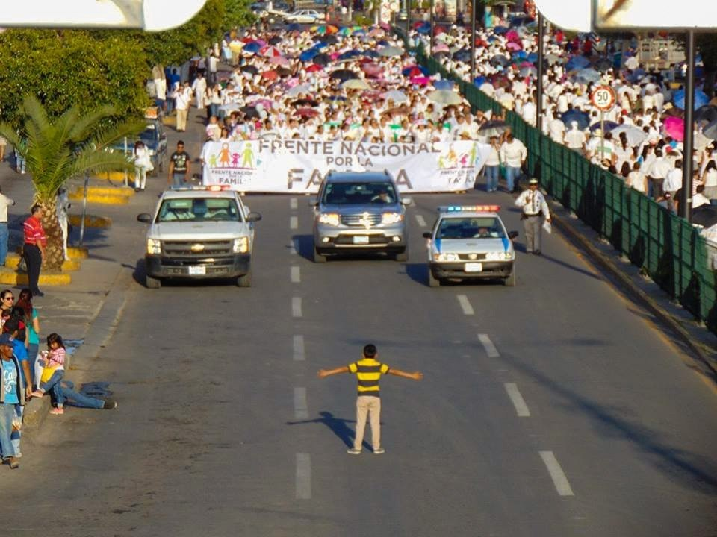
Warm Up 14
After looking closely at the image, think about these three questions:
• What is an assumption you can make regarding this photo?
• What do you see that makes you say that?
• Predict what will happen next
Respond to each question with at least one sentence.

