Slide 1
Warm Up #1
Read the text below.
Notice the use of descriptive imagery by Steinbeck to paint the setting.
Think of a place that you know so that you could describe it like Steinbeck does above.
Create a setting to share with the class.
A few miles south of Soledad, the Salinas River drops in close to the hillside bank and runs deep and green. The water is warm too, for it has slipped twinkling over the yellow sands in the sunlight before reaching the narrow pool. On one side of the river the golden foothill slopes curve up to the strong and rocky Gabilan Mountains, but on the valley side the water is lined with trees- willows fresh and green with every spring, carrying in their lower leaf junctures the debris of the winter's flooding; and sycamores with mottled, white, recumbent limbs and branches that arch over the pool. On the sandy bank under the trees the leaves lie deep and so crisp that a lizard makes a great skittering if he runs among them. Rabbits come out of the brush to sit on the sand in the evening, and the damp flats are covered with the night tracks of ‘coons, and with the spread pads of dogs from the ranches, and with the split-wedge tracks of deer that come to drink in the dark.
There is a path through the willows and among the sycamores, a path beaten hard by boys coming down from the ranches to swim in the deep pool, and beaten hard by tramps who come wearily down from the highway in the evening to jungle-up near water. In front of the low horizontal limb of a giant sycamore there is an ash pile made by many fires; the limb is worn smooth by men who have sat on it.
In the center of Cuernavaca, Mexico lies a Cathedral dating back over two hundred years. It’s grey walls are chipped and cracked from centuries of war and weather. It is surrounded by a calming yard filled with trees and flowering bushes adding color to the otherwise dreary setting. The cathedral’s walls are tall and cast long shadows down alleyways that connect streets and homes. Down one of those alleyways cloaked in darkness is a staircase leading to a door with no numbers or signs, only a knocker. Beyond this door is a mystery to those that stand before it, for the walls surround the building are too tall to see over and there are no windows to peer through. However, should you knock and the owners of that door open it, and they most surely would, you would find yourself surrounded by yet another yard, more of a garden. Also, you would find friendship and a home. This was my home away from home during my stay in Cuernavaca.

Slide 2

Of Mice & Men- Chapter 2
WARM UP#2
Define the following terms from Chapter 2 using a dictionary. No phones.
Skeptically-
Relish (v.)-
Pugnacious (adj.)-
Ominously-
Derogatory-
Brusquely-
Answer in a complete sentence:
What did George tell Lennie to do at the end of Chapter 1?

Slide 3
Warm Up #3-Compare Settings
  Read both paragraphs
Contrast the World of Nature and the World of Man that Steinbeck presents through the setting in each chapter.
  Which would you prefer and why? 2. Identify a part of the paragraph that seems attractive to you and explain why it is.
Chapter 1- World of Nature
Chapter 2- World of Men
A few miles south of Soledad, the Salinas River drops in close to the hillside bank and runs deep and green. The water is warm too, for it has slipped twinkling over the yellow sands in the sunlight before reaching the narrow pool. On one side of the river the golden foothill slopes curve up to the strong and rocky Gabilan Mountains, but on the valley side the water is lined with trees— willows fresh and green with every spring, carrying in their lower leaf junctures the debris of the winter’s flooding; and sycamores with mottled, white, recumbent limbs and branches that arch over the pool. On the sandy bank under the trees the leaves lie deep and so crisp that a lizard makes a great skittering if he runs among them. Rabbits come out of the brush to sit on the sand in the evening, and the damp flats are covered with the night tracks of ‘coons, and with the spread pads of dogs from the ranches, and with the split-wedge tracks of deer that come to drink in the dark.
The bunk house was a long, rectangular building. Inside, the walls were whitewashed and the floor unpainted. In three walls there were small, square windows, and in the fourth, a solid door with a wooden latch. Against the walls were eight bunks, five of them made up with blankets and the other three showing their burlap ticking. Over each bunk there was nailed an apple box with the opening forward so that it made two shelves for the personal belongings of the occupant of the bunk. And these shelves were loaded with little articles, soap and talcum powder, razors and those Western magazines ranch men love to read and scoff at and secretly believe. And there were medicines on the shelves, and little vials, combs; and from nails on the box sides, a few neckties. Near one wall there was a black cast-iron stove, its stovepipe going straight up through the ceiling. In the middle of the room stood a big square table littered with playing cards, and around it were grouped boxes for the players to sit on.

Slide 4
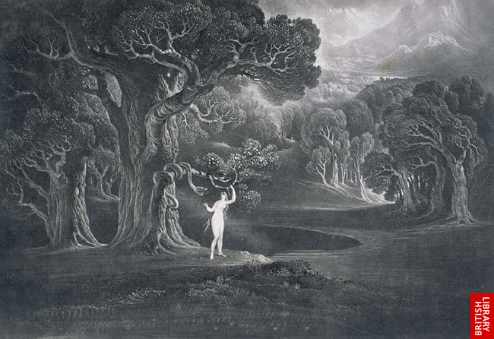
Quick Write #3a
Explain why you think Steinbeck named his characters George Milton and Lennie Small. (One sentence each)

Slide 5

What do George and the one-handed old man Candy have in common?
  They are both caretakers of something in need.
    Candy → Old Dog
    George → Lennie
Warm Up #4

Slide 6

Of Mice & Men- Ch. 3
Warm Up#5
Do you believe Candy should have shot his dog himself? Why or why not?
(4-5 sentences)

Slide 7
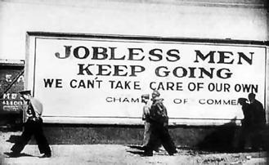
Warm Up #6
Observe the photo. Write 4-5 sentences about what you notice. Can you make any connections to Of Mice and Men?

Slide 8
Of Mice & Men Chapter 4- Begin
Warm Up#7
Define these five terms in your Warm Ups:
Aloof (adj.)-
Fawning (adj.)-
Apprehension (n.)-
Indignation (n.)-
Crestfallen (adj.)-

Slide 9
Of Mice & Men
Quick Write 7
Analyze & Explain:
Why do bullies behave the way they do?

Slide 10
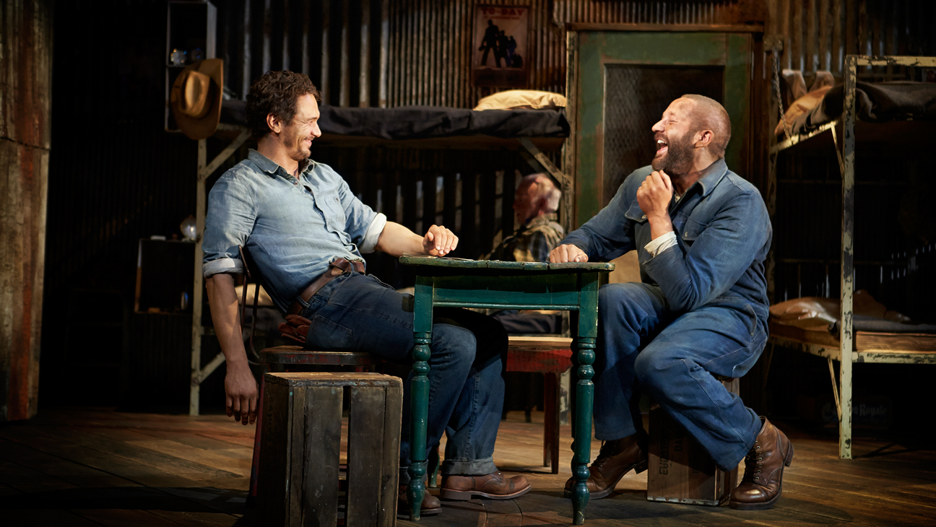
Warm Up#8
Yesterday, we discussed bullies and how they target weakness in others.
For your warm up today, think about your greatest weakness or flaw. Be honest with yourself; this may be very beneficial for you going forward in life.
If we are able to be honest about our faults, then no one can use them against us.
Wrtie about your greatest weakness. 3-5 sentences.

Slide 11
Warm Up#9
What can the reader infer about Curley’s wife when she goes to the barn? (Sentence stem + 2 examples= 3 sentences)
Sentence stem:
When Curley’s wife goes to the barn, the reader understands ____________________________________________________________________.
One trait= 2 examples
Two traits= 1 example for each trait

Slide 12



Warm Up #10
Go to www.emsisd.com/Ssurvey_1617
Click the here link

