Slide 1
2nd 6 Weeks Warm-Ups

Slide 2
Warm Up #1 (Label on a NEW PAPER)
What is the main message Dr. Gladwell conveys in the video?
https://www.youtube.com/watch?v=XS5EsTc_-2Q

Slide 3
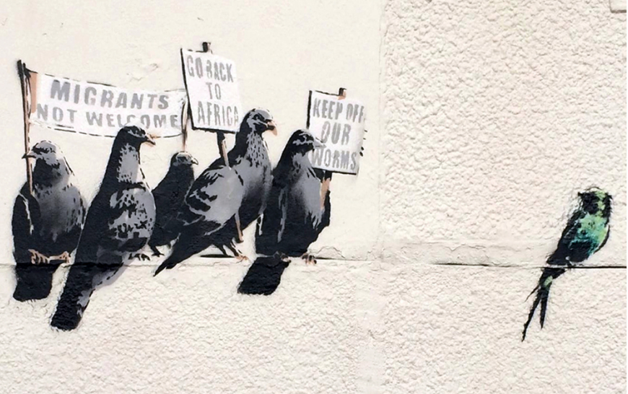
Warm Up #2:
Identify the subject of Banksy’s graffiti painting. (one sentence)
Write a thematic statement for the painting:
In Banksy’s graffiti painting, he (analysis verb) that (subject) + (what does Banksy say about that subject).

Slide 4
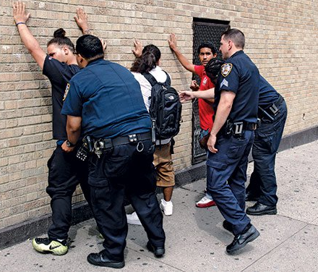
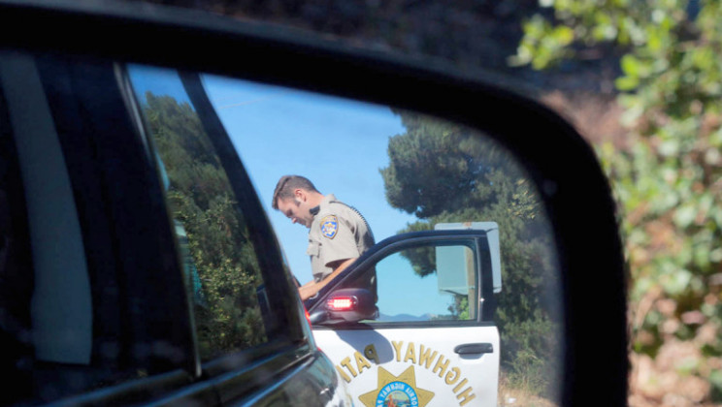
Warm Up #3- Empathize
You’re walking along with your friends. Three police officers walk up and stop you and your friends. You’re asked if you’re doing anything illegal. They ask you to put your hands up for a routine check.
How are you feeling? Explain. (2-3 Sentences)
It’s your first day on the police force. You’re excited and ready to help your community. On your first patrol duty, you notice a car driving strangely. The driver is actively avoiding your squad car. You flash your lights and pull over the vehicle. When running the plates, nothing comes up but as you look up from the computer screen you seen the driver close his center console. He either put something away, or he pulled something out.
2) How are you feeling? Explain. (2-3 sentences)

Slide 5
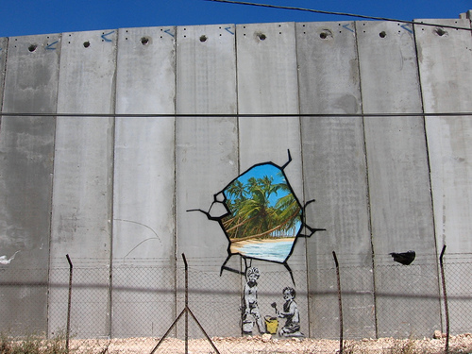
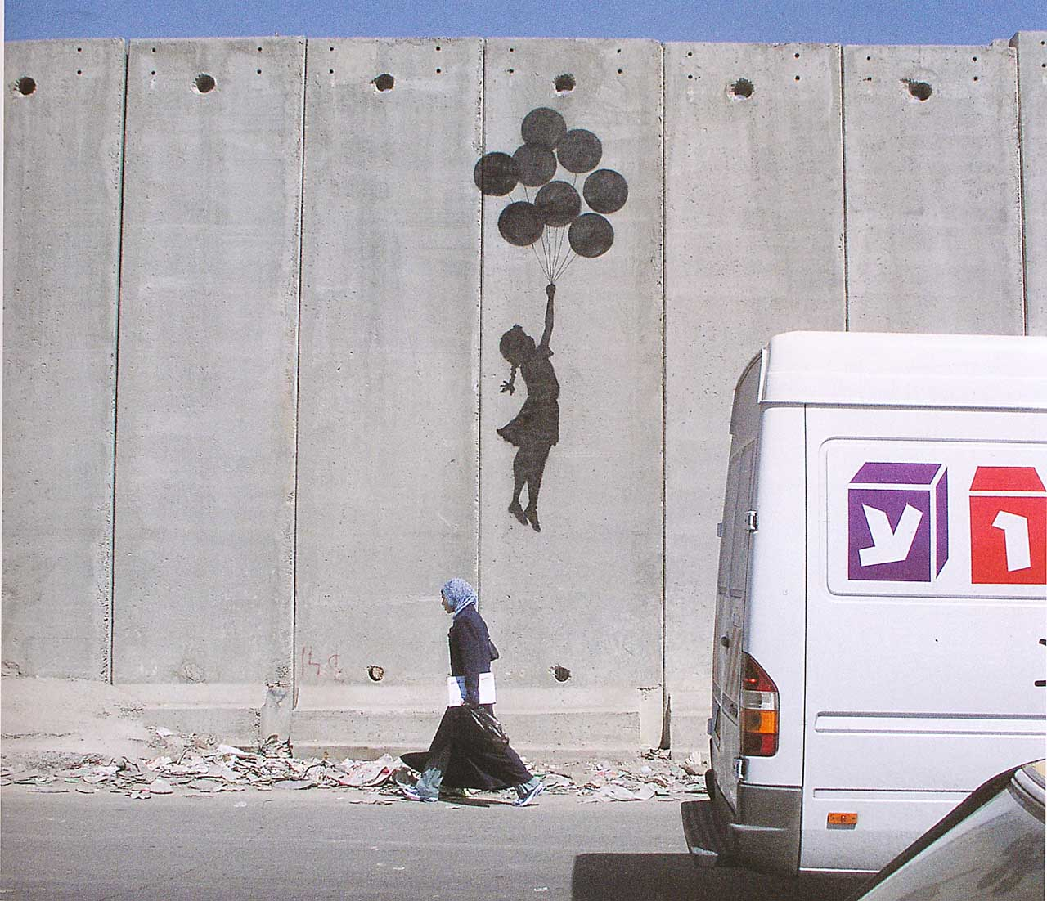
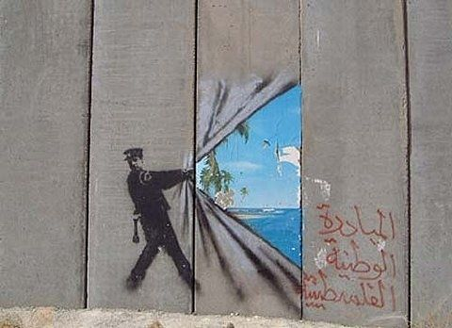
First, look up WEST BANK on your phones.
Write down the significance of the West Bank Wall.
Next, what SUBJECT do you think Banksy is commenting about?
Explain your reasoning.
Warm #4

Slide 6
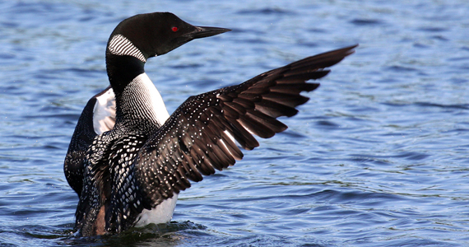
Warm Up #5
Warm Up#5
The Loon
by Lew Sarett
A lonely lake, a lonely shore,
A lone pine leaning on the moon;
All night the water-beating wings
Of a solitary loon.
With mournful wail from dusk to dawn
He gibbered at the taunting stars,—
A hermit-soul gone raving mad,
And beating at his bars.
For today’s warm up, you will be completing a SOAPSTone for “The Loon” by Lew Sarett.
Speaker:
Occasion (Context):
Audience:
Purpose:
Subject:
Tone:

Slide 7
Warm Up#6
Images can be drawn from all sorts of things we observe in life. For each category, create two images—one pleasant and one unpleasant. Try to include images that appeal to all five senses.
Images | Pleasant | Unpleasant
Animal images
Flower images
Water images
Sky images
Earth images
City images
Country images

Slide 8
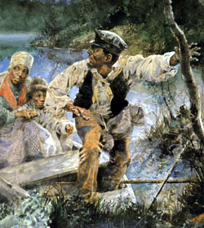
“And then we cowards”- by Cesare Pavese
And then we cowards
who loved the whispering
evening, the houses,
the paths by the river,
the dirty red lights
of those places, the sweet
soundless sorrow—
we reached our hands out
toward the living chain
in silence, but our heart
startled us with blood,
and no more sweetness then,
no more losing ourselves
on the path by the river—
no longer slaves, we knew
we were alone and alive.
Warm Up #7
Complete the SOAPSTone for “And Then We Were Cowards.”
Speaker:
Occasion (Context):
Audience:
Purpose:
Subject:
Tone:

Slide 9
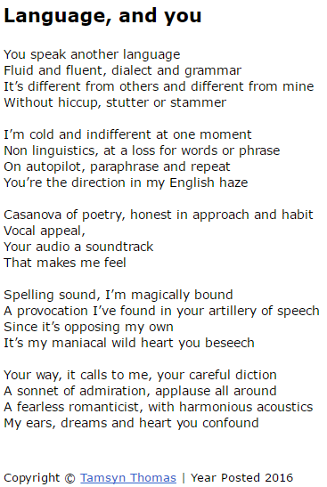
Warm Up #8
First, attach this poem into your warm ups.
Next, with your group, identify the following parts:
Figurative Language:
Simile- comparison using like or as
Metaphor- comparison of two nouns
Personification- humanlike qualities
Imagery- appeals to senses (not just sight!)

Slide 10
Now, create a
Modified
Theme statement
Welcome!
Warm Up #9
figurative language
imagery
For Warm Up #9, copy the below modified THEME STATEMENT.
Modified Theme Statement:
Title + Genre + Author’s Name + Analysis Verb (from list) + ,(through the use of [device]), + Subject (what should the reader learn)
Copy this example:
“Sunday Candy,” a song by Chance the Rapper argues, through the use of figurative language, that love comes in many forms.
Now, create your own by choosing one of your slides, either imagery or fig. lang., and create a theme statement for your song. You may use this on your Slide 3.

Slide 11
Warm Up #10 (5-7 Sentences)
A.
Do you think fame and wealth necessitate change within people?
Is Richard Rodriguez’s relationship with his family (described in the excerpt Hunger of Memory”) more similar to or more different from your relationships with your own family? Explain.
B.

